Slide 1

ANTITRUST TREATMENT OF NONPROFITS: SHOULD HOSPITALS RECEIVE SPECIAL CARE?
By Cory Capps, Dennis W. Carlton and Guy David
NBER Working Paper 23131

Slide 2
SHOULD HOSPITALS RECEIVE SPECIAL CARE?
Abstract
Favorable Tax treatment
Suppression of competition
Cross-subsidize Care for needy Populations
Nonprofit Hospitals
Socially Beneficial Activities
Premise: Nonprofit hospitals with great market power provide more care to the needy

Slide 3
SHOULD HOSPITALS RECEIVE SPECIAL CARE?
Abstract
Welfare implications of an antitrust policy that favors nonprofit hospitals
Market Power
Charity Care Provision
Link
2 Dollar-Denominated
test
3 Measures of Charity Care
For-profit Hospitals
1 Service Volume
Non-profit Hospitals

Slide 4
SHOULD HOSPITALS RECEIVE SPECIAL CARE?
Content
1
Introduction
2
Background
3
Models of nonprofit objectives and constraints
4
Empirical analysis of uncompensated care, nonprofit status and market power
5
Conclusion

Slide 5
SHOULD HOSPITALS RECEIVE SPECIAL CARE?
Introduction
Situation
Short-term, non-federal, general hospitals in US Composition Pie Chart
Source: American Hospital Association, Fast Fact on US Hospitals, January 2014

Slide 6
SHOULD HOSPITALS RECEIVE SPECIAL CARE?
Introduction
General Concepts
1
What are the nonprofit hospitals?
What’s the relationship between nonprofit hospitals and antitrust laws?
2
3
What is the uncompensated care?

Slide 7
SHOULD HOSPITALS RECEIVE SPECIAL CARE?
Introduction
1
What are the nonprofit hospitals?
Hospitals are designated as nonprofit if they do not distribute profits and deemed to provide sufficient public benefits, such as charity care.
In exchange, nonprofit hospitals receive financial benefits, including exemptions from federal income taxes and state property taxes.

Slide 8
SHOULD HOSPITALS RECEIVE SPECIAL CARE?
Introduction
What’s the relationship between nonprofit hospitals and antitrust laws?
2
But, if nonprofit hospitals use their profits to provide public benefits, should a nonprofit hospital be able to defend itself against an antitrust claim by arguing that an increase market power it achieves will enable it to increase its provision of public benefits, even if the prices to some patients rise?
As noted, the tax laws do provide favorable treatment. Should the antitrust law do the same?
Under antitrust laws, nonprofit hospitals typically do not receive an analogous concession in recognition of their provision of public benefits, although some courts on older cases used nonprofit status as a basis for lenient antitrust treatment.
Most commonly, actions by nonprofit hospitals that would increase market power, such as mergers, joint ventures, collective price setting, or other conduct such as tie-in sales, are precluded because increased market power is presumed to harm consumers by increasing price and reducing outputs.

Slide 9
SHOULD HOSPITALS RECEIVE SPECIAL CARE?
Introduction
3
What is the uncompensated care?
Uncompensated care is an overall measure of hospital care provided for which no payment was received from the patient or insurer. It is the sum of a hospital's "bad debt" and the charity care it provides.
Bad debt consists of services for which hospitals anticipated but did not receive payment.
Charity care, in contrast, consists of services for which hospitals neither received, nor expected to receive, payment because they had determined, with the assistance of the patient, the patient’s inability to pay. (http://www.aha.org/content/00-10/10uncompensatedcare.pdf)

Slide 10
SHOULD HOSPITALS RECEIVE SPECIAL CARE?
Introduction
Overall, economics theory indicates that a balancing of social benefits against harm from market power may be appropriate under the assumption that nonprofits will provide greater social benefits when they have greater market power.
This paper evaluates whether there is systematic empirical evidence that nonprofit hospitals do in fact increase their provision of uncompensated care in response to the increased market power.

Slide 11
SHOULD HOSPITALS RECEIVE SPECIAL CARE?
Background
The provision of the benefits could depend on a suppression of competition.
Eg. Two food organizations
Public benefits of the challenged behavior outweigh the adverse effects of lessened competition.
Eg. MIT case, Department of Justice sued universities/ District Court/ Appellate Court
With merging, the nonprofit hospitals consistently raise their status as a defense.
Eg. The merger of Butterworth Hospital and Blodgett Memorial Medical Center /The District Court denied the Federal Trade Commission’s motion for an order to block the merger.
Notes:
Two firms might agree to divide a city in half and serve spearate halves to economize on resources

Slide 12
SHOULD HOSPITALS RECEIVE SPECIAL CARE?
Background
2 Rationales
Two possible rationales for more lenient antitrust treatment of nonprofit hospitals
Nonprofit hospitals would not exercise any market power they might gain
They will do so, but in ways that are socially valuable

Slide 13
SHOULD HOSPITALS RECEIVE SPECIAL CARE?
Background
Rationale. 1
Nonprofit hospitals would not exercise any market power they might gain
Nonprofits do charge higher prices in more concentrated markets. (Simpson and Shin, 1998; Dranove and Ludwick, 1999; Keeler et al. 1999)
Nonprofit hospitals increase price when they gain market power through merger. (Vita and Sacher, 2001; Krishnan, 2001; Haas-Wilson and Garmon, 2011; Thompson, 2011; Tenn, 2011)

Slide 14
SHOULD HOSPITALS RECEIVE SPECIAL CARE?
Background
Rationale. 2
They will do so, but in ways that are socially valuable
Nonprofits and for-profits respond similarly to financial incentives and do not differ in how they spend incremental funds on the charity care. (Duggan, 2000, 2002)
There’s no evidence in support of more favorable antitrust treatment for nonprofit hospitals. (Garmon, 2009)

Slide 15
SHOULD HOSPITALS RECEIVE SPECIAL CARE?
Background
Problems
Analyze on the dollar value of charity (Garmon, 2009)
Dollar-denominated measures of charity or uncompensated care have been subject to rapid list price inflation and may be poor representation of hospitals’ ability to translate their surplus into provision of unprofitable services, and it may be affected by accounting principles.
Did not control for the competitive environment (David et al., 2014)
Therefore, they did not look at whether any differential behavior towards the provision of charity care between nonprofits and for-profit hospitals depends on the market power.

Slide 16
SHOULD HOSPITALS RECEIVE SPECIAL CARE?
Background
Firstly, this paper explores a more direct, volume-based measure of uncompensated care, which is unlikely to be affected by differences in accounting principles across hospitals.
Secondly, they also examine whether nonprofit hospitals expend their rents in a socially beneficial way by maintaining unprofitable service lines, a practice that benefits all patients, not just charity care patients.
Finally, they examine 11 years of data, allowing the researchers to capture greater variability and leverage changes in hospitals’ market power and ownership status. This in turn allows researchers to rely on the panel aspects of their data as opposed to relying primarily on cross-sectional variation.

Slide 17
Theoretical Models
Philipson and Posner(2009) develops an altruistic nonprofit firms model
Utility derived from output in addition to profits
Competition still maximizes social benefits
Should not distinguish between for-profit and nonprofit
Notes:
With this output preference, firms are allowed to account for an externality of production
They will charge a lower price than their profit-maximizing price to provide more service due to the externality
However, paper shows that even with such altruists firms, competition still maximizes social benefits

Slide 18
Theoretical Models
Sufficient funding to subsidize the consumption of the poor
If not, ability to exercise market power is crucial
Value same externality for consumption of all consumers
Rich people can afford health care consumption
Should only value that of poor people at α
Notes:
However, this paper found that the previous conclusion will be reversed if its assumptions are relaxed a bit
First assumption, that is firms are “rich altruists”. Under competition, they charge p1=c and p2=c-a for two groups. Here, firms are losing money, and if there is financial restraints, they could only charge uniform price of p = c and provide no service to poor people.

Slide 19
Theoretical Models
Less competition could relax the financial constraint faced by nonprofit firms, so they can afford to provide services to the poor people
It is necessary to charge differential price to the rich and the poor. Competition makes such price discrimination hard.
Notes:
The new hypothesis given by authors are:
So firms can use the profits from the rich to subsidize the uncompensated care for the poor
If one firm raise the price, another firm will grab all the rich people market

Slide 20
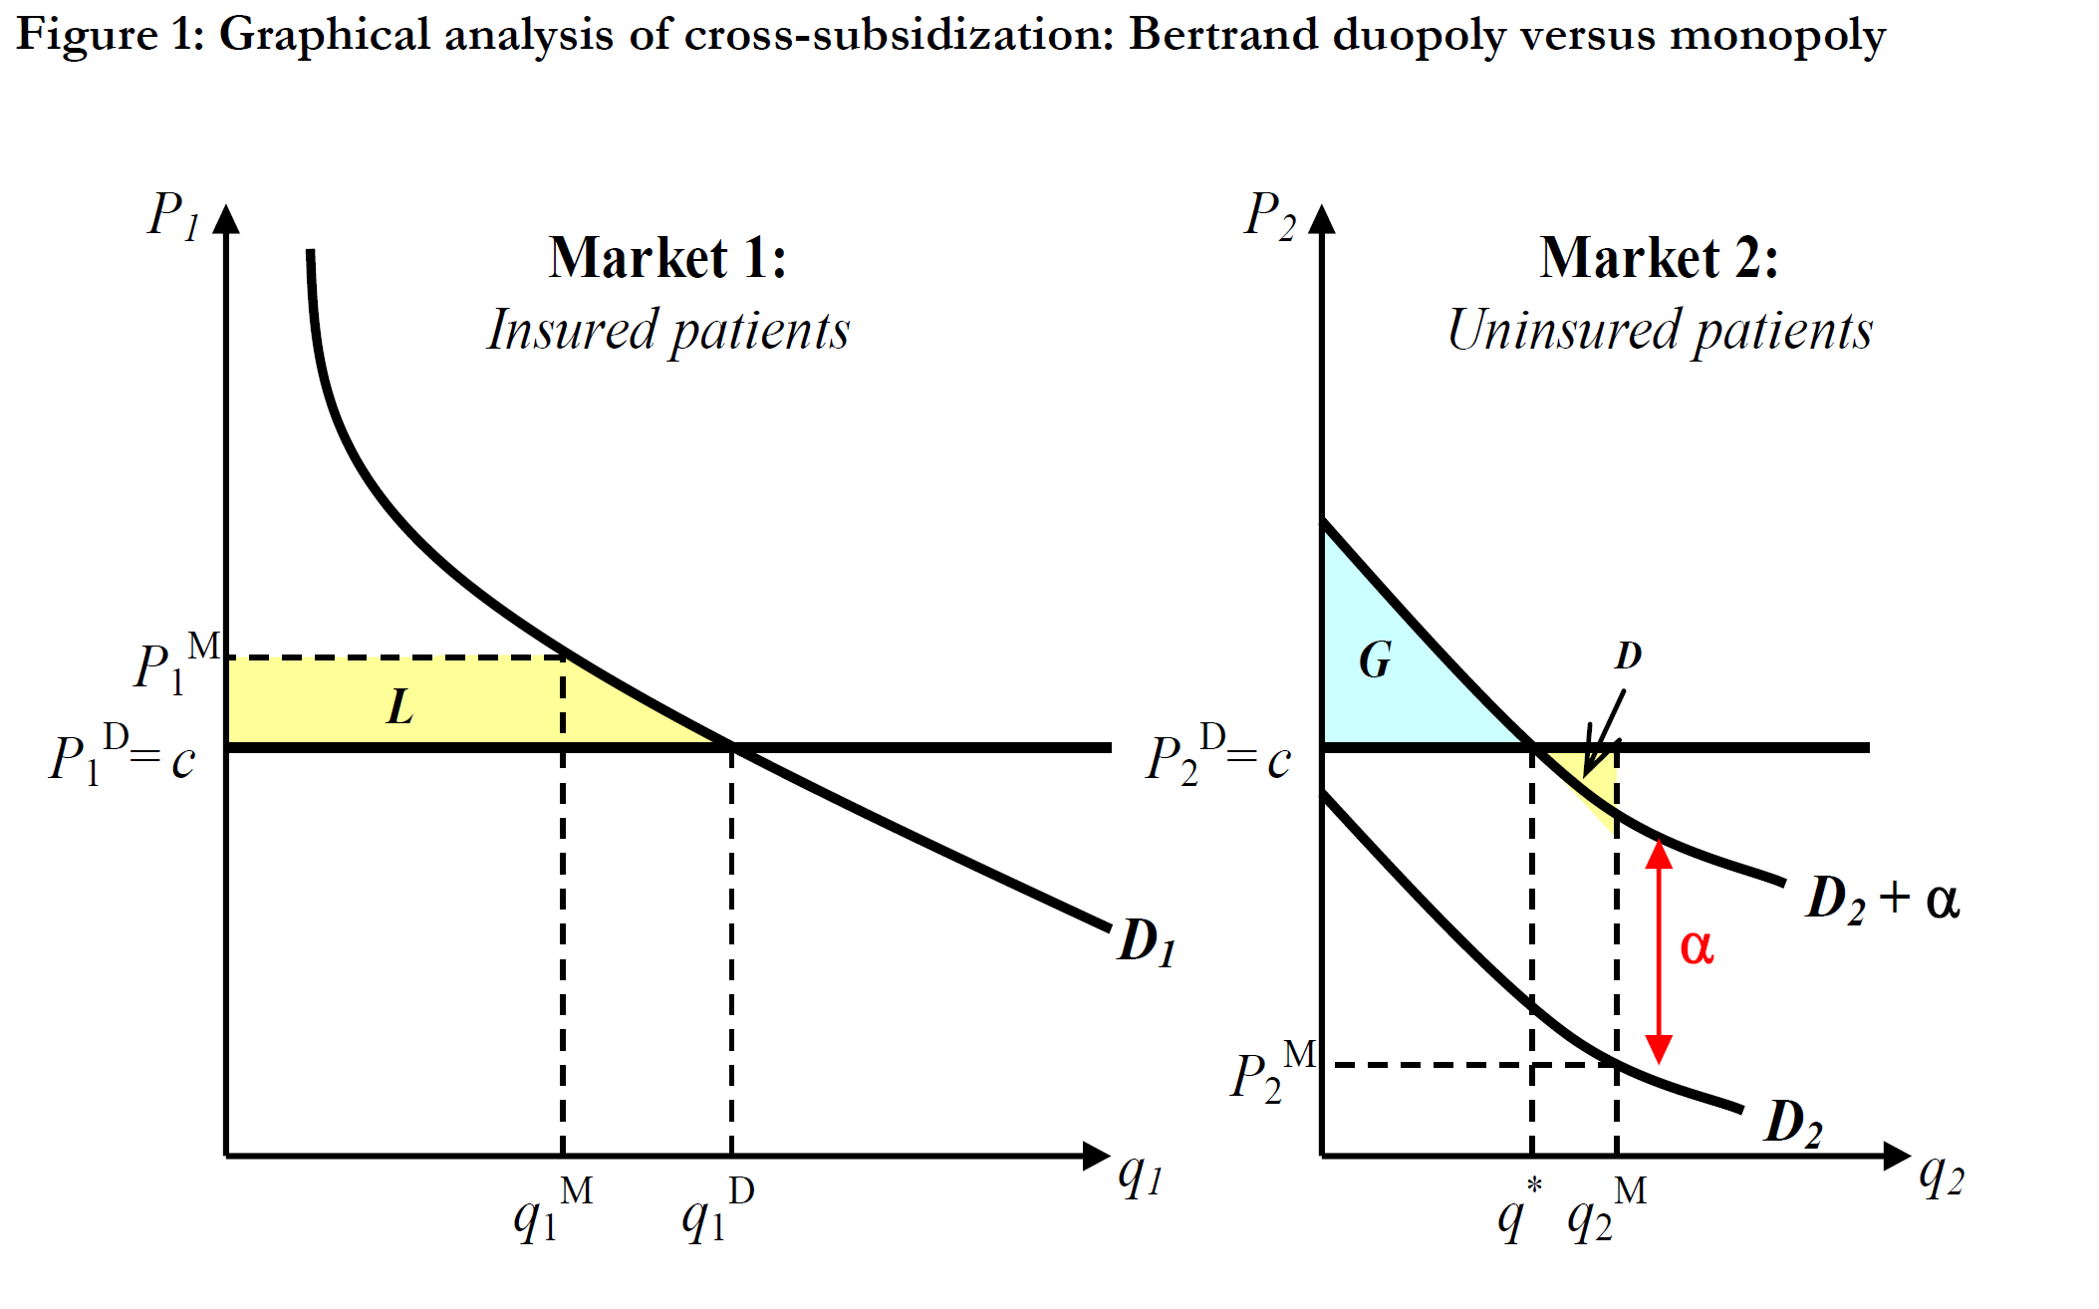
Theoretical Models

Slide 21
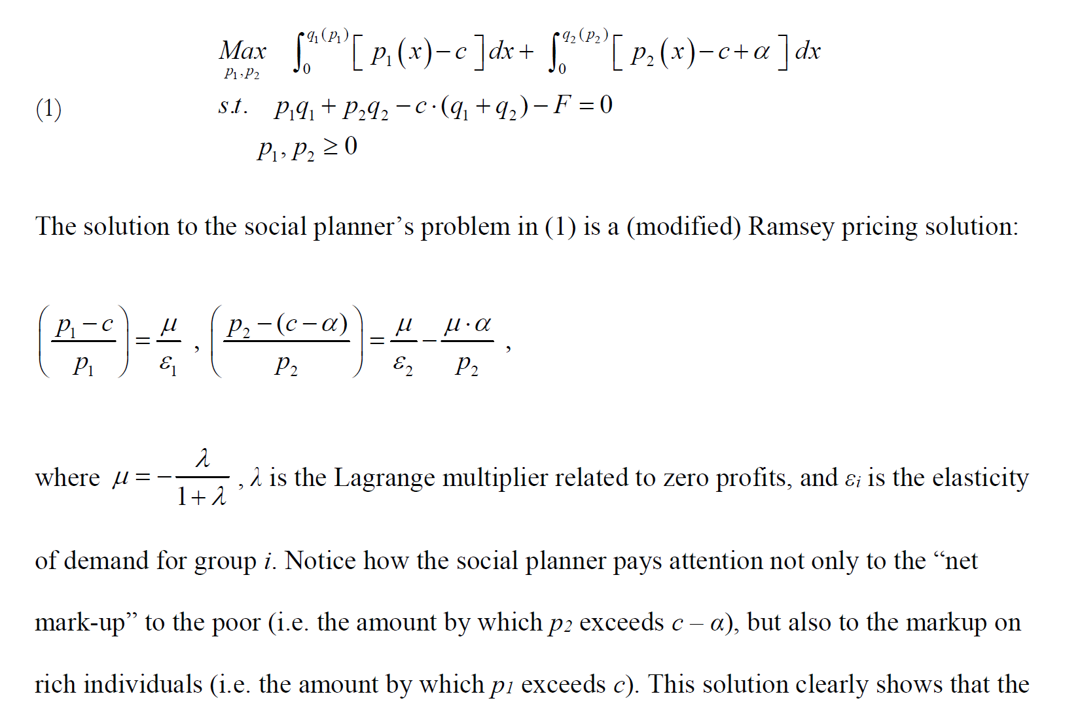
Theoretical Models

Slide 22
Empirical Evidence
11-year panel of data on California hospitals from 2001 through 2011
Uncompensated care, defined as charity care + bad debt
Using list price for services, which are usually discounted for the insured patients
Biased estimate for the charity care provision

Slide 23
Empirical Evidence
Instead, using DRG weights, the index of how a patient is time costly to treat in different hospitals, to measure volume of services provided to uninsured patients
Dollars-based measure vs. volume-based measure of charity care

Slide 24
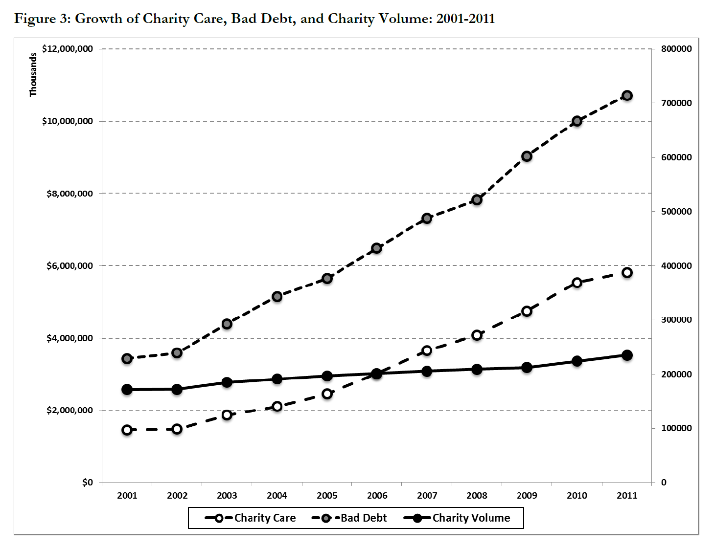
Empirical Evidence

Slide 25
Empirical Evidence
Measuring Competition
HHI for each hospital:
First, calculate the HHI based on observed market share of patients in a “micromarket”. Then calculate hospital-specific HHI as the weighed sum of “micromarket HHIs”.
The weight is the share of patients from each micromarket.

Slide 26
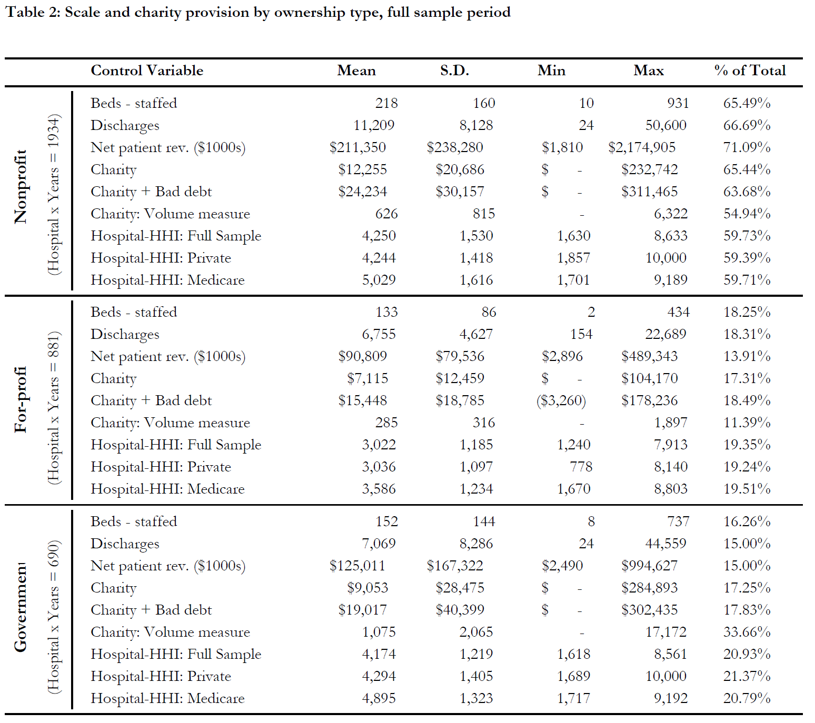
Empirical Evidence
Notes:
Disproportionately low share of total charity care provision, especially for volume measure
By theoretical model, the low level of charity care could be the result of competitive pressures that preclude cross-subsidizing uncompensated care
However, it also shows nonprofit hospitals face less competition
This casts doubt on the hypothesis that with greater market power, nonprofit hospitals generate bigger social benefits rather than the harm of less competition

Slide 27
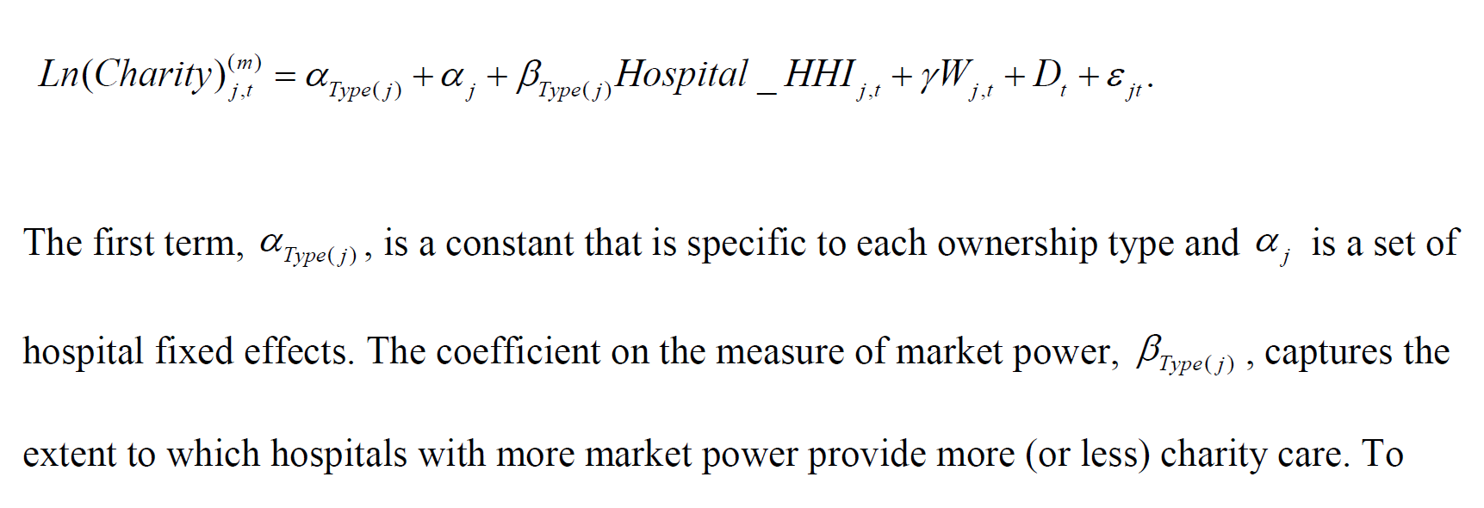
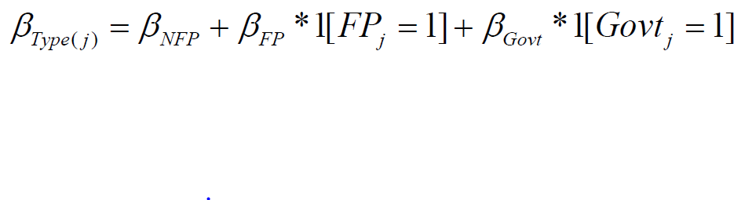
Empirical Evidence

Slide 28
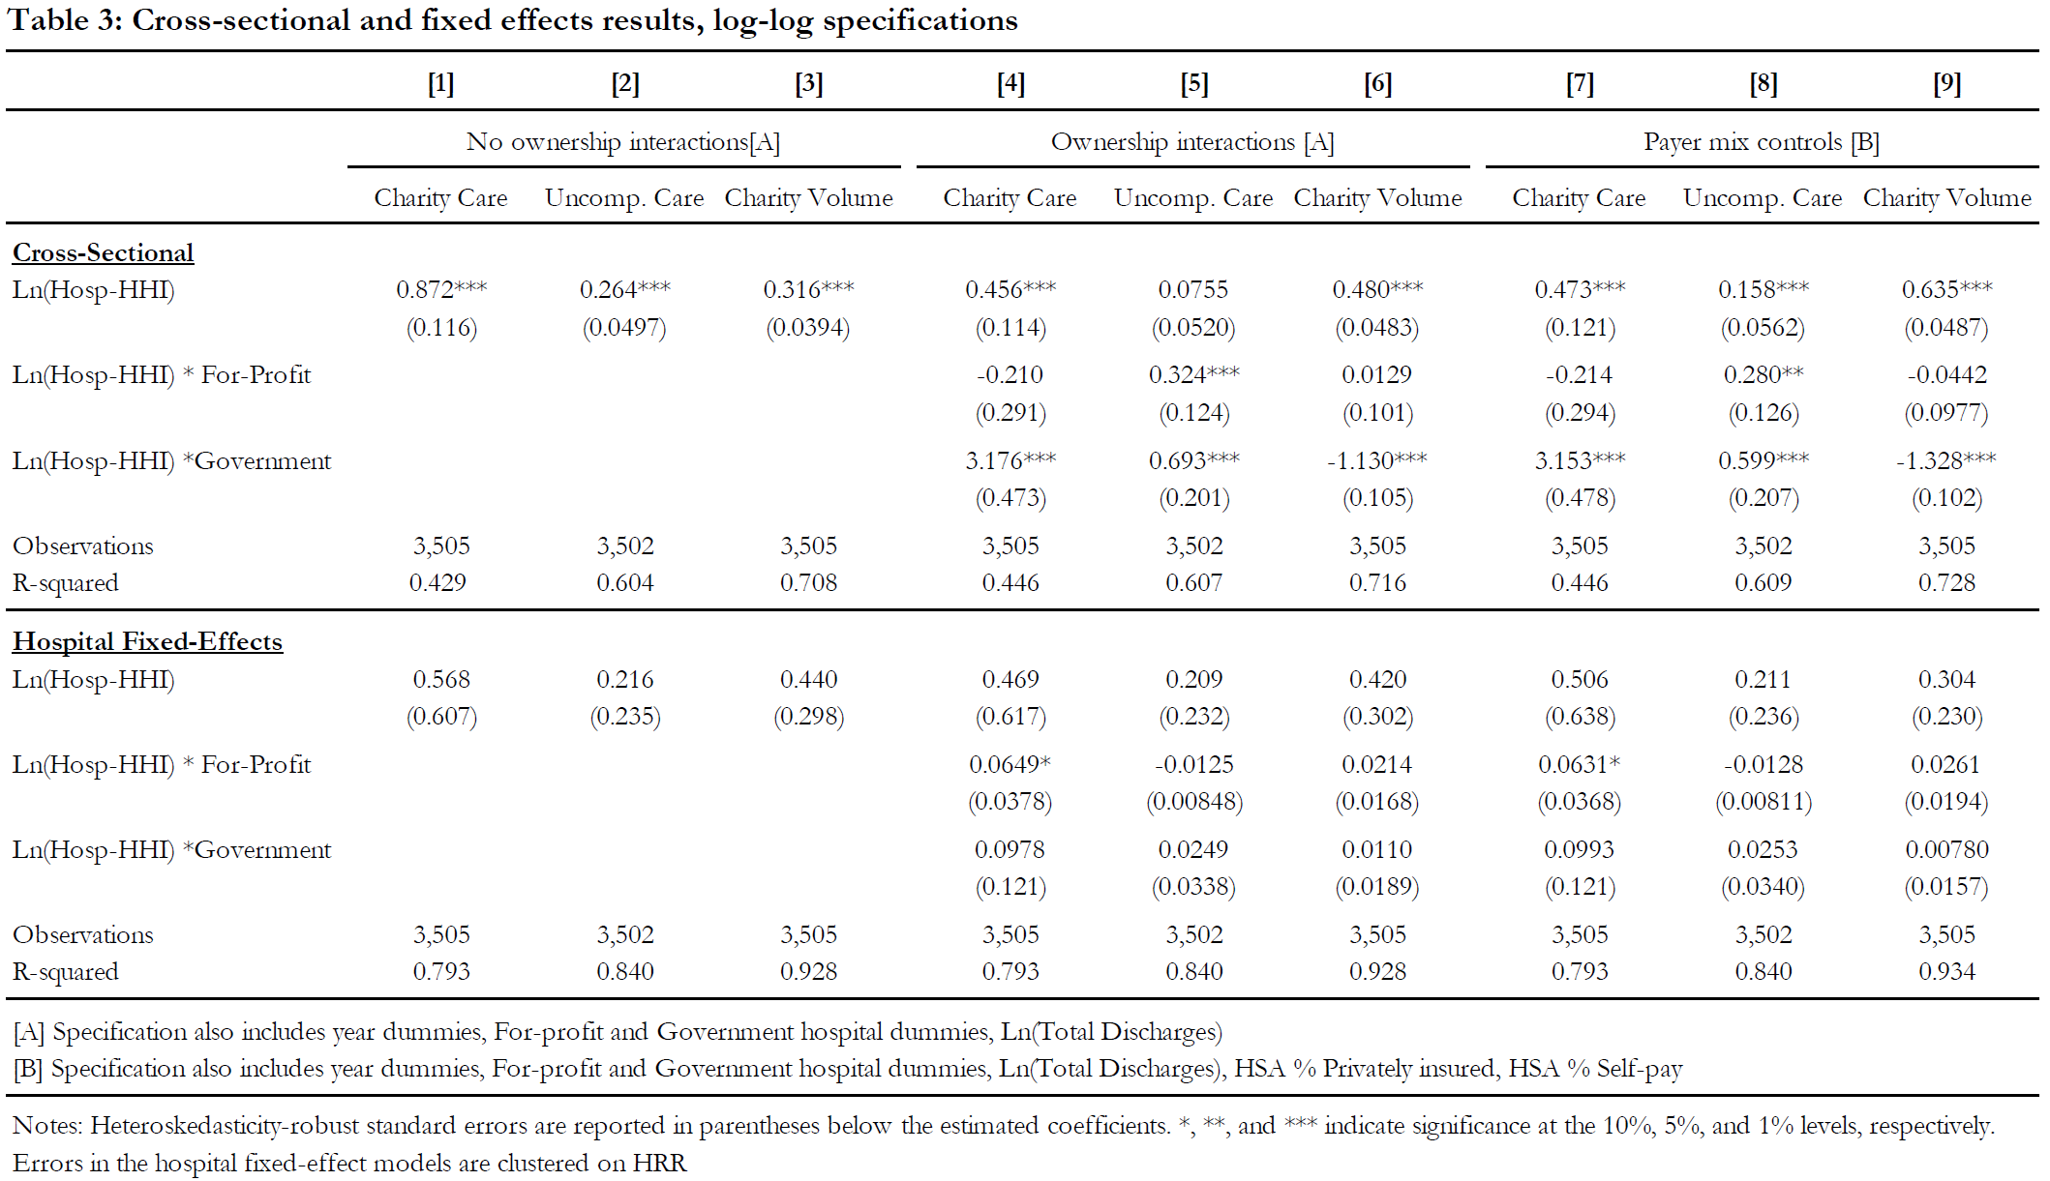
Empirical Evidence

Slide 29
Empirical Evidence
Unprofitable services approach
nonprofits are no more likely to offer these services as concentration increases than are for-profit hospitals.
These services are generally more likely to be provided by hospitals in more concentrated markets, but this is not confined to nonprofit hospitals
Notes:
psychiatric care, rehabilitation, the emergency department, trauma services, burn care, and labor and delivery

Slide 30
Empirical Evidence
Travel pattern approach
Travel time of insured and uninsured patients in the top 25% of changes in hospital-HHI
Travel time of insured patients increase by 16%
That of uninsured patients remained constant
Notes:
Increased market power does not lead to a hospital drawing uninsured patients from a broader area
suggests that there is a fixed volume of uninsured patients, irrespective of market power

Slide 31
SHOULD HOSPITALS RECEIVE SPECIAL CARE?
Conclusion
Researchers find no empirical evidence that nonprofit hospitals increase their charity care as they acquire greater ability to do so through increased market power.
They also find that, after controlling for their sizes, nonprofit hospitals provide only marginally more uncompensated care than do for-profits hospitals.
Moreover, the authors find that controlling for the sizes, government-run hospitals, rather than nonprofit hospitals, provide a disproportionately high amount of uncompensated care.

Slide 32
Overview and Critique
Bertrand competition
Volume measurement
Notes:
Bertrand competition assumption, uninsured patients who require immediate medical attention are legally enforced to be treated, so any hospital has to provide charity care
There could be other reasons for uninsured patients to go to hospitals, e.g. service quality, which might be positively correlated to concentration
Time spent on patients could be endogenous with patients’ condition. Insured patients may afford better medicines and recover faster. So this volume measurement may enlarge the charity service.

Slide 33

Presented by : Andong Yan Xingchen Ye

